Slide 1
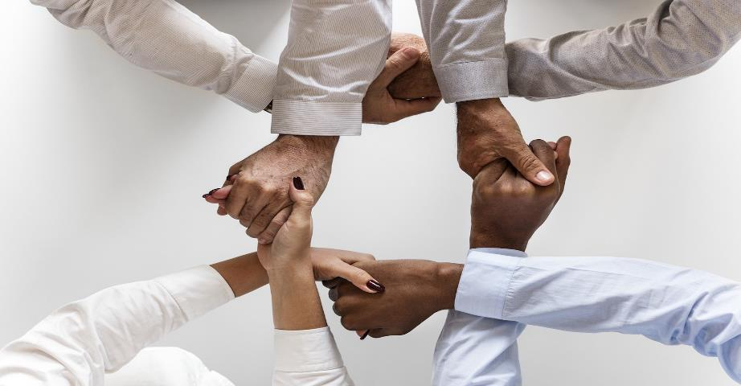
Negotiated Workplace Learning Week 6
Building Relationships
Sandra Okwara

Slide 2
Aims
Understand the need to build good relationships
Understanding good relationships
Importance of Building Relationship
Barriers to building relationship
Strategies for building good work Relationships

Slide 3
Why Build Relationships?
Humans are Naturally social creatures (Social Creatures)
1/3 of human lives are spent at work
Good relationships with colleagues make the job enjoyable
Colleagues feel more comfortable and confident to voice out their opinions and accept new ideas if they are comfortable around their colleagues.
To embrace create and change n the workplace., team members require team work
There is an increase in morale and productivity when team members have a good working relationship.
Career progression is better developed with good professional circle.

Slide 4
Good Relationship
Trust is required for a good work relationship in the workplace. When individuals trust their team members, openness and honesty improves and lees time is spent watching your back.
A good relationship requires Respect as it helps team members to value each other’s input and promotes solutions to problems in the workplace
Self Awareness is an important aspect of building good work relationships as every individual takes responsibility for their words and actions without letting individual negative emotions have an impact on team member.
Cultural Competence and inclusion should be part of building relationship by accepting and welcoming the diverse people and opinions in making decisions in the workplace
Effective communication by creating an open and honest communication with each other in the team helps keep the team together.

Slide 5
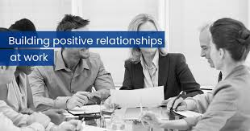
Main Working Relationships
Relationship will all co workers
Focus on the manager
Team members
External Stakeholders

Slide 6
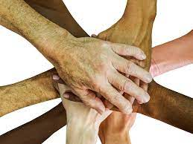
Barriers to building Relationship
Lack of emotional intelligence
Conflicts in the workplace
Lack of time
Lack of resources
Gossiping about team members
Negativity in the workplace
Lack of Appreciation of others and what they do .
Difficult team members

Slide 7
Ways to build relationships at work
Identify your relationship needs in the workplace ( What do you need from others ? What do others need from you?
Develop people Skills ( Collaborate, communicate and solve conflicts)
Embrace Positivity :Positive thinking is often associated with positive actions and outcomes.
"A man is but the product of his thoughts. What he thinks, he becomes.“
Mahatma Gandhi, Indian leader

Slide 8

Ways to build relationships at work
Plan time to build Relationships
Development of your own emotional intelligence
Appreciate your team members
Be aware of your boundaries
Talk about conflicts and clear them

Slide 9
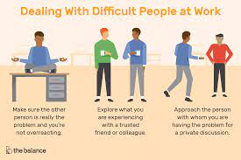
Dealing with Difficult team members
Reflect on the good times between the two of you . This can strengthen the broken cord
Check your attitude, behaviour and how it affects others attitude and behaviour towards you.
Helps to avoid sitting and spending time in one position
Impact assessment and review of the breaks is important
Informal breaks can cause time wasting
Can cause advice seeking from the wrong individuals
Can increase/ decrease confidence in individual’s decision making

Slide 10
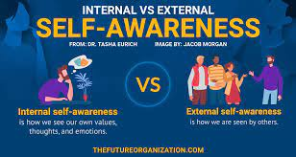
Self Awareness
Self-awareness is the ability to look inward, think deeply about your behaviour, and consider how it aligns with your moral standards and values.
When your behaviour is out of alignment with your standards, you feel uncomfortable, unhappy and negative.
When your behaviour and values are aligned, you feel positive and self-confident.
Self-awareness also gives you a deeper understanding of your own attitudes, opinions, and knowledge.

Slide 11
Importance of self awareness
Self awareness has a strong link with high performance in the workplace
Being aware of your strengths and weaknesses gives you the power to intentionally use your strengths and eliminate your weaknesses
Self awareness supports with career progression
Being aware of yourself creates more confidence in approaching others.

Slide 12
Developing self awareness
Understand your personalities
Understanding how your personality compares with the personalities of other people can help you discover what motivates you, and how you relate to the world. Both of these are important aspects of self-awareness.
Reflect on your impact on others
Being self-aware, you understand how you instinctively think, connect with other people, communicate, and make decisions. This helps you think about what does and doesn't work for you, and helps you be more aware of your impact on other people.
Focus on Others
Being self aware helps you become conscious of your words and actions and the influence on other people. Take time to weigh what you say carefully, and think about how it will affect the person that you're speaking to. Get Feedback.

Slide 13
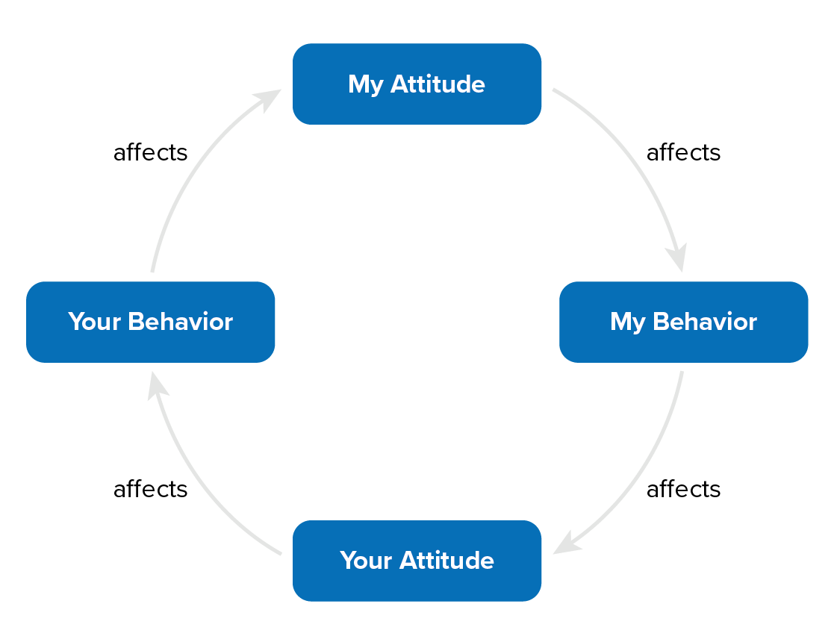
Betari box Model

Slide 14
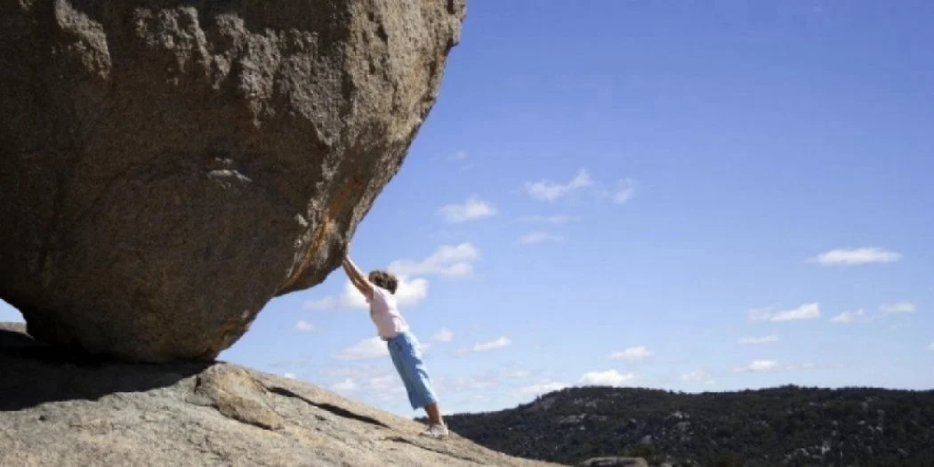
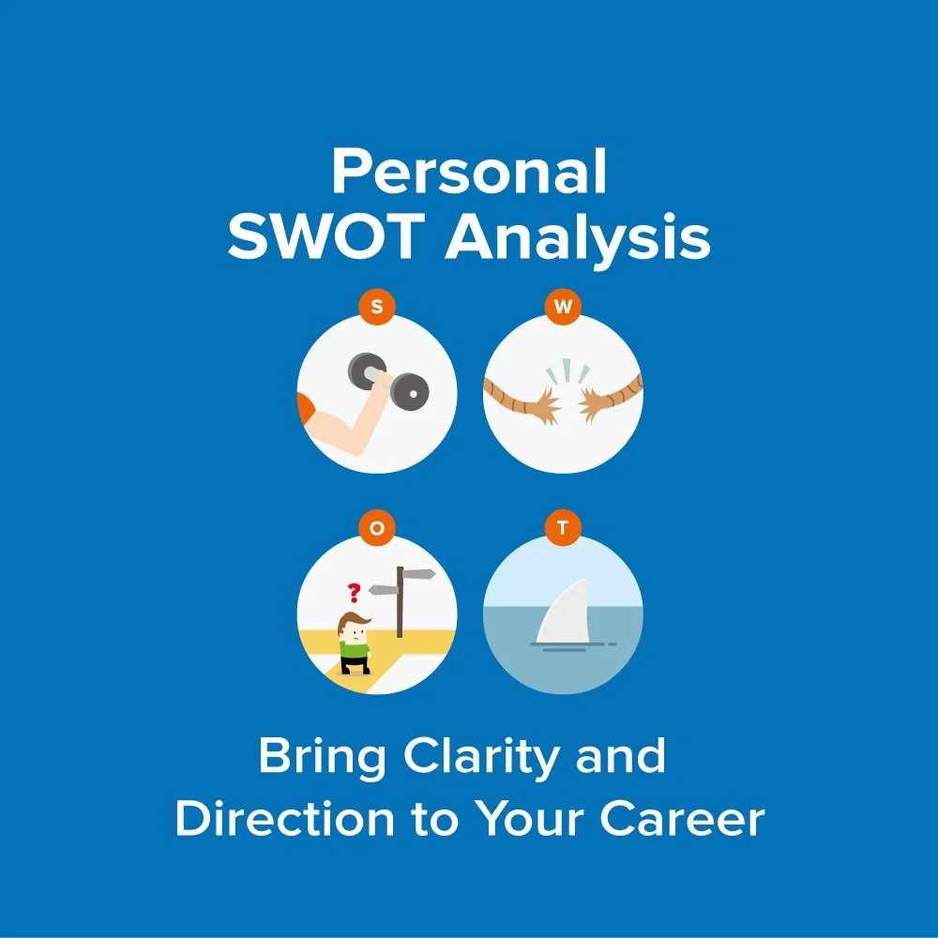
Developing Self awareness

Slide 15

Things to remember about you in the workplace
Your attitude affects the people around you
When you feel negative about a relationship, STOP! Assess your own behaviour and attitude and focus on the positive aspects of the relationship
You have a choice of how you respond to negative situations
If a team member is negative, explore the negativity with them
Practice Empathy!

Slide 16
Review learning ?
What have we learnt
What changes will you make from now?

Slide 17
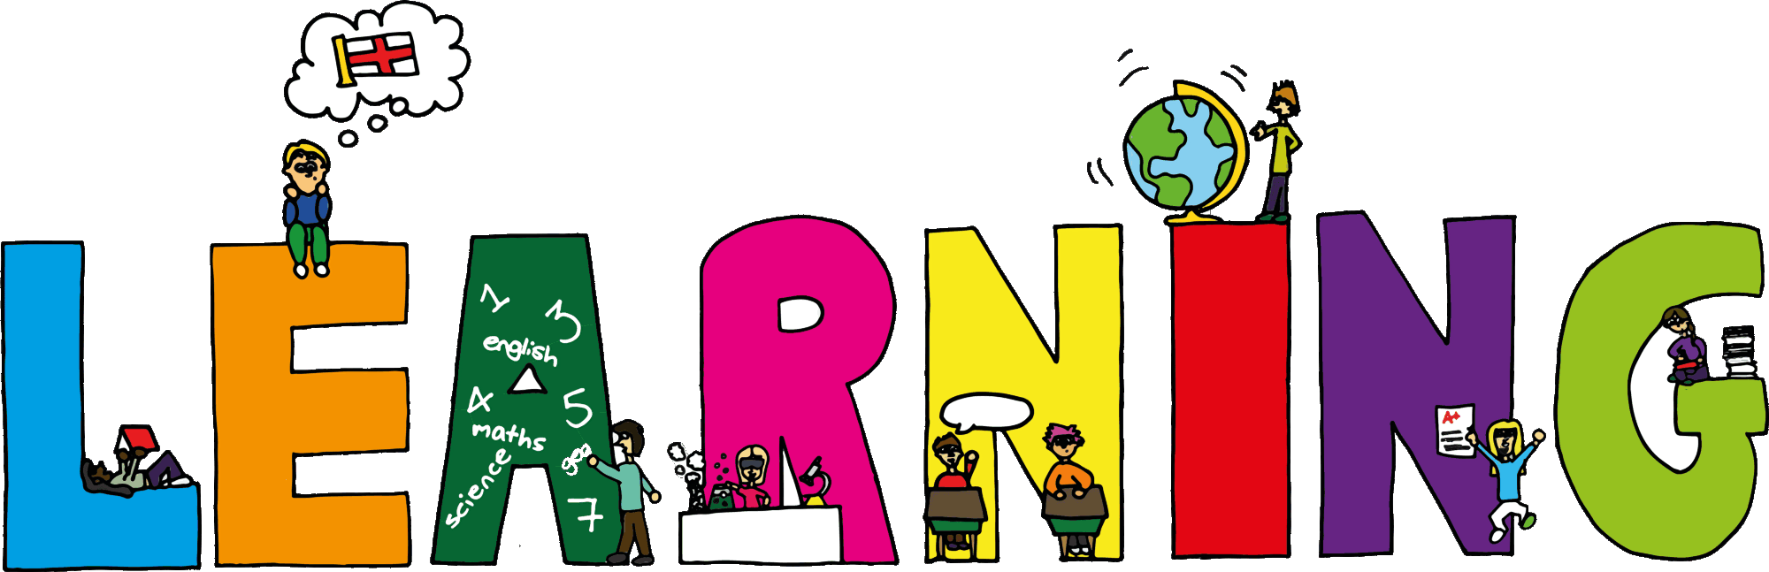
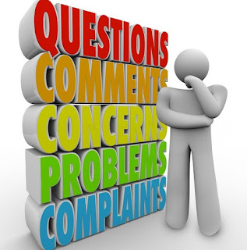
What have you Learnt?

